Slide 1
RENTAL DWELLINGS DESIGNATED FOR THE PENSIONERS AND THE ELDERLY
HELPS meeting
Ljubljana, 25. – 26. 2. 2013

Slide 2
MAIN GOALS
purchasing,
maintaining and
managing of a housing fund which is designated and rented out to pensioners and the elderly.
Legal entity i.e., the Pension Real Estate Fund L.t.d. in close cooperation with the associations of the elderly and local communities.

Slide 3
TARGET GROUP
Pensioners and the elderly.
Eligibility criteria:
pensioner or an elderly normally over 65 years old
medical conditions allow for independent living
is economically capable to pay rent and maintenance (income threshold)
does not have outstanding payment of rent (only for those already in non-profit dwellings)

Slide 4
TARGET GROUP
Criteria for ranking on the short list for a particular dwelling:
housing status and current housing conditions of the applicant
health conditions
status of the old-age pensioner
age
location of permanent residence (favourable if in the same area as particular dwelling available for renting)
waiting period for Fund's dwelling

Slide 5
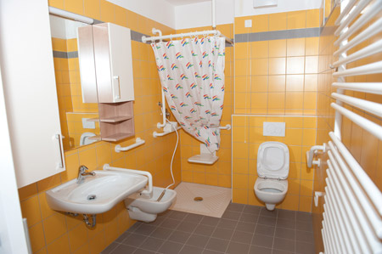
COVERAGE OF THE PRACTICE:
2.917 rental dwellings,
avg size 37m2,
occupied on avg by 1,4 person;
ttl 4.084 tenants represents
1,2% of pop 65+,
avg tenant 69,8 years old,
72%F, 28%M

Slide 6
STRENGHTS
intensive and extensive cooperation with all actors within housing field (from municipalities to policy makers);
cooperation with end users and their associations (tenants; local associations of pensioners);
monitoring of the quality of existing housing fund and providing adaptation to new needs and standards;
developing new forms of cooperation and integration of new projects and networks in the operation of the Fund (e.g. with "Elderly for Higher Quality of Life"

Slide 7
STRENGHTS
having an educational role by informing elderly about opportunities for the improvement of their quality of life including informational support to the relatives of the elderly;
constant consideration of economic conditions of end users and efforts to maintain rents at a level affordable for the tenants;
developing marketing strategy and promoting rental dwellings by using new technologies and opportunities (web etc.), but also in a manner close to the elderly, which are not high-tech orientated (personal calls; meetings; radio);
following new trends and forms of housing provision and services for the elderly and adapting own practice (or planning to adapt) adequately.

Slide 8
PARTICIPATION OF ELDERLY:
Cooperation with associations of pensioners (surveys among elderly; annual meetings, opinions, comments, suggestions.
Discussions with tenants; conducting surveys; meetings with tenants; events
Through the management authorities: a representative of pensioners/the elderly is a member of the Supervisory Board (proposed by NGOs of the elderly). One third of the Assembly of the Fund are pensioners or elderly persons.

Slide 9
Thank you for your attention!

