Slide 1
Info point for improvement of housing situation of old people
HELPS meeting
Ljubljana, 25. – 26. 2. 2013

Slide 2
Main goals
Information and counseling.
Involvement of all stakeholders.
Media campaign and promotion of alternative housing arrangements.
Using a logic model to monitor inputs, outputs and outcomes
Using logic model to monitor inputs, outputs and outcomes - impact.

Slide 4
Information and counseling
62 users/enquiries
(in Nov 2012 – Feb 2013 period)
Variety of issues
retirement homes
sheltered housing and nursing homes
home care assistance
senior cohousing
refurbishment and adaptations of dwellings in an age-appropriate manner,
legal support on estate/housing options

Slide 5
Involvement of all stakeholders
Setting up LSG
27 meetings with organisations /institutions (from different fields)
housing (residential care homes, sheltered housing)
home care
architecture
smart home
advocacy for elderly
aids and equipment
youth
research
media
internet marketing
real-estate

Slide 6
Media and promotion campaign
General public
TV shows
news
articles
internet articles
Internet (ZDUS webpage, facebook)
Old people
specialised magazines
internet
word to mouth
Promotion
brochures
leaflets
public presentations
Experts
papers
publications

Slide 7
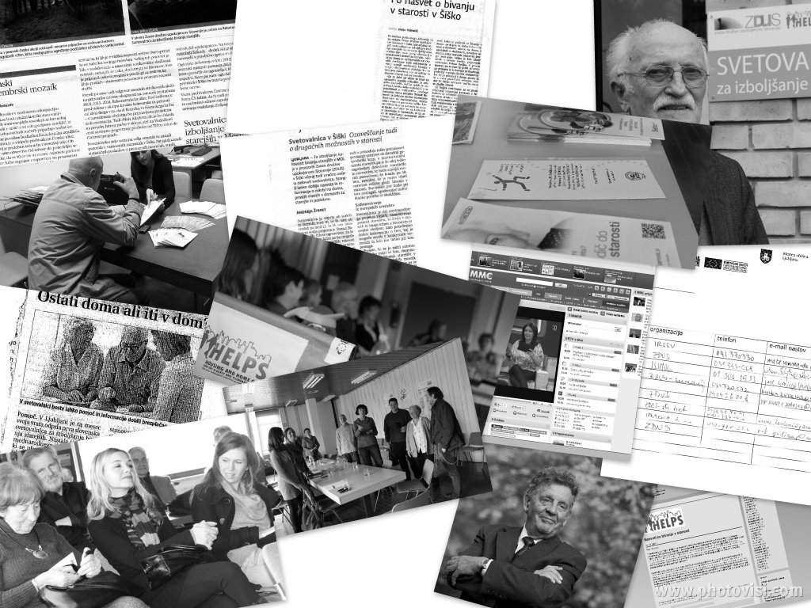

Slide 8
Thank you for your attention!

