Slide 1
PILOT ACTION - POLAND Ambient Assisted Living: facilitating ICT-based innovation in housing and care for elderly and disabled
Michał Kosiedowski, Poznań Supercomputing and Networking Center

Slide 2
The aim of the Poznań-based PA
Objective 1: application of open Ambient Assisted Living platform as a basis of a ICT-based care services and applications
Goal 1.A: verification of the suitability of AAL platforms (universAAL) for real-life scenarios
Goal 1.B: adaptation of selected AAL applications for use on the AAL platform
Objective 2: setting up a ‘living laboratory’ to facilitate development of innovative care solutions based on ICT
Goal 2.A: design of a strategy (recommendation) on how to develop, pilot, test and mainstream new AAL applications in bottom-up approach
Goal 2.B: creation of synergies between stakeholders: research, local administration, NGOs and business sector
Participants:
15+ end beneficiaries
5+ carers

Slide 3
AAL applications
App1. Personalized informant
end beneficiaries: elderly
local partner: Centre for Senior Citizens Initiatives
App2. E-manager of daily activities
end beneficiaries: intellectually disabled
local partner: „Na tak” Association
App3. Shared e-Health
end beneficiaries: elderly
local partner: day care centre
App4. Geolocation monitoring
end beneficiaries: elderly/ intellectually disabled
local partner: ……()/„Na tak” Association
App5. Smart housing support
end beneficiaries: elderly/ intellectually disabled
local partner: ……()/„Na tak” Association

Slide 4
Local context: motivation (1)
PolSenior study results
healthcare needs of the elderly: prevention
hypertention – 76%
obesity / overweight – 70%
chronic kidney disease – 45%
improper level of glucose – 40%
COPD – 18%
hyper- or hypothyroidism – 10%
accessibility of free medical examination in cities:
50,000+ residents: 25% elderly say access is difficult
500,000+ residents(e.g. Poznań): bigger percentage say access is difficult, 8% say it is extremely difficult
dementia: 1 in 3 elderly

Slide 5
Local context: motivation (2)
Silhouette project survey (own research )
60% want homecare vs. 4% want institutional care
want to use computers (and other ICT) for:
better contact with relatives and friends
gathering information: daily and concerning health
problems:
loneliness
access to healthcare
poor living conditions
ICT could support:
hobbies
healthcare
security

Slide 6
Local context: motivation (3)
Needs advertised by stakeholders
Centre for Senior Citizen Initiatives: information provision
„Na tak” Association
household management
management of daily activities
security on the move

Slide 7
Implementation plan
November 2012: concept elaboration – completed
December 2012-March 2013: purchase of equipment – in progress
December 2012-June 2013: development and adaptation of AAL applications - in progress
June-August 2013: enrollment of applications in real-life settings
July-October 2013 : evaluation of the pilot applications
September-December 2013: seminars and workshops with extended range of stakeholders (PSNC’s co-working facility)

Slide 8
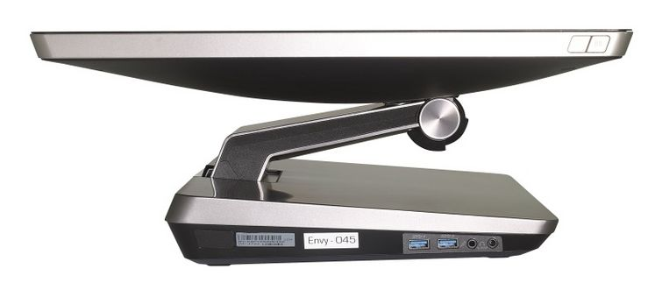
Equipment (1): AAL gateways
Touchscreen PC
Based on Windows 8
Number: 16 (10 delivered)

Slide 9
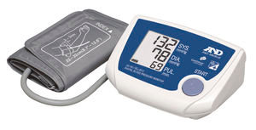
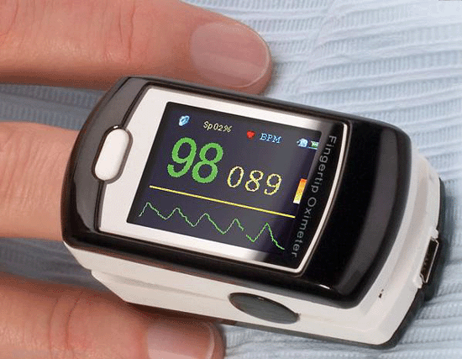
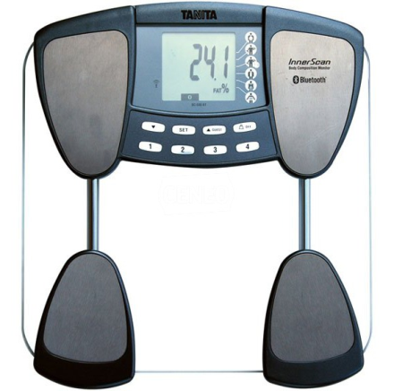
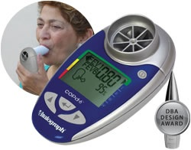
Equipment (2):e-health devices
Blood pressure monitor
Pulse oximeter
Scales with body composition analyzer
Spirometer (COPD screening device)

Slide 10
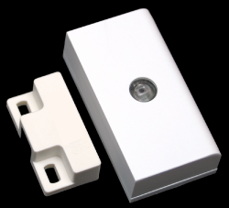
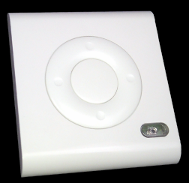
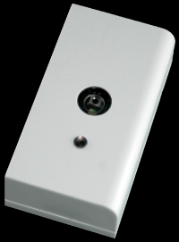
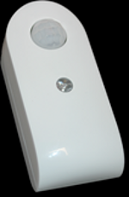
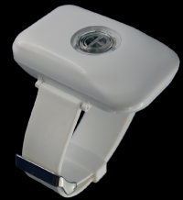
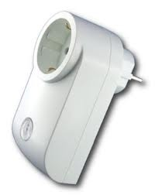
Equipment (3): smart sensors
Temperature sensor– 2 pcs
Motion detector – 2 pcs
Illuminance sensor – 2 pcs
Fall and pulse detector- 1 pc
Door/window sensor – 1 pc
Electric power consumption sensor – 2 pcs
Sensor network coordinator – 1 pc

Slide 11
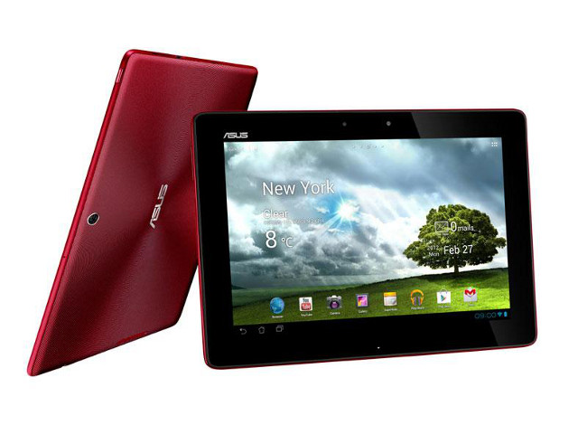
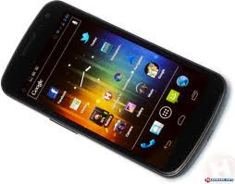
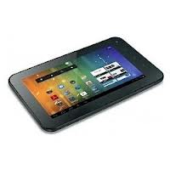
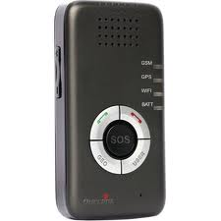
Equipment (4): mobile devices
10” tablets (for carers) – 5 pcs
Smartphone – 1pc
7” tablet – 1 pc
GPS tracker– 1 pc

Slide 12
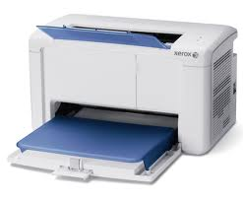
Equipment (5): other
Computer switch for disabled – 2 pcs
Printer – 1 pc
Server – 1 pc

Slide 13
Thank you for your attention!

