Slide 1


PARTNER MEETING AND NETWORKING EVENT IN HUNGARY
Bakonyvári-Koós Eszter (PP6 – Municipality of Debrecen)
Mészáros Eszter (PP7 – Hungarian Maltese Charity Service)

Slide 2
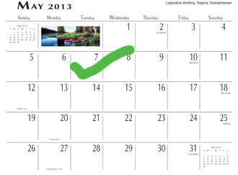
Date of the event:
7-9 May 2013
Place of the event:
Debrecen & Budapest

Slide 3
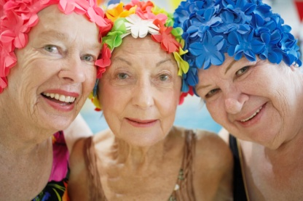
PLANNED PROGRAM
7 May 2013
City of Debrecen
Afternoon session starting at 13.00
TWG meeting→ WP 4-related sessions
Study visit at one of the LSG members
Dinner in Debrecen

Slide 4
PLANNED PROGRAM (2)
8 May 2013
Debrecen/Budapest
Morning session (9.00 – 14.00)
SC/TWT meeting
→ WP1, WP2 and WP5-related sessions
Transfer to Budapest
Dinner in Budapest

Slide 5

PLANNED PROGRAM (3)
9 May 2013
Budapest
HELPS/Silver City/Senior Capital Networking Event

Slide 6



HELPS/Silver City/Senior Capital networking event
Linked to the HELPS partner meeting on 7-8 May
Corresponding to Action 4.1.6. in WP4 (originally planned as Q-Ageing Networking event)
Date: 9 May 2013 (half-day event)
Venue: Hotel Zara, Budapest
Organizers:
PP7 - HMCS
PP6 - Municipality of Debrecen
Municipality of Zugló (Budapest, Hungary)

Slide 7

HELPS/Silver City/Senior Capital networking event (2)
Aim: exchange of good practices and lessons learnt amongst CE and SEE projects similar to HELPS
Proposed title: Good Practice Fair on Ageing: supporting older people to have an active, autonomous and healthy life.
Participating projects:
  HELPS☺
  Silver City (SEE):
    Objectives: to create better conditions for seniors to remain active in the society, focusing on financial & instutional aspects, social services and quality of the urban living

Slide 8
HELPS/Silver City/Senior Capital networking event (3)
  Senior Capital (CE):
    Includes most of the Q-Ageing partnership
    Objectives: to better exploit the economic potential of an ageing population by
    investing in human capital of 50+ seniors
    promoting their involvement in economic activities
    creating new & financially sustainable frames catalysed by municipalities.

Slide 9


PLANNED AGENDA
1. Plenary session:
  Welcome
  Introducing the topic in EU policy/strategy context (Ageing Platform, DG Employment, other speakers experts in the theme of the conference etc.)
  Short introduction of the projects by LPs: HELPS, Silver City, Senior Capital – Q-Ageing
2. Parallel workshop session:
  parallel workshops in 3-4 topics
  (exact topics to be decided!) in smaller groups
  structure of each workshop: the short presentation
  of good practices will be followed by a free discussion
  (with a moderator)
3. Plenary session:
  Closing remarks

Slide 10


CURRENT TASKS RELATED TO THE MAY EVENTS
Please mark in your calendar!
Make travel arrangements (information on travel&accommodation will be sent to you soon after the Ljubljana event)
As regards to the networking event:
  Suggest speakers for the plenary session
  LP will select good practices to be presented and will approach partners to appoint presenters

Slide 11
Ďakujem
Hvala
Grazie
Děkuji
THANK YOU
Köszönöm
Dziękuję
Danke

