Slide 1
COMMUNICATION PRIORITIES - Communication Plan Implementation & Dissemination-
HELPS Project Transnational Workshop
25-26 February 2013, Ljubljana, Slovenia
Gabriela PREDA
Communication Manager HELPS
Project Lead Partner:
This project is implemented through the CENTRAL EUROPE Programme co-financed by the ERDF

Slide 2
Talking Points
Operational Communication Plan
Communication Tasks PPs
SWOT Analysis (selection)
What’s next?

Slide 3
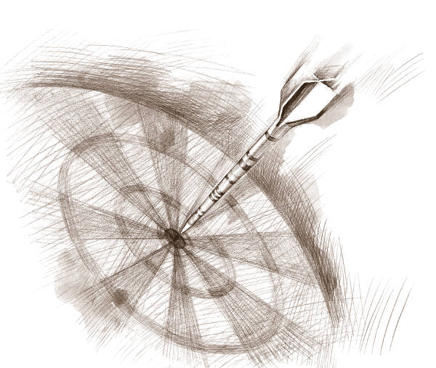
Operational Communication Plan
The purpose is to support the Project objectives and its Strategic Communication Plan (a general framework), approved in 2012
The plan serves as a guiding map for internal and external operational communication actions regarding HELPS for various target audience(s) and provides a flexible and dynamic structure that will allow changes to the initial planning (depending on PPs & public feedback).
The focus is on the Project Added Values

Slide 4
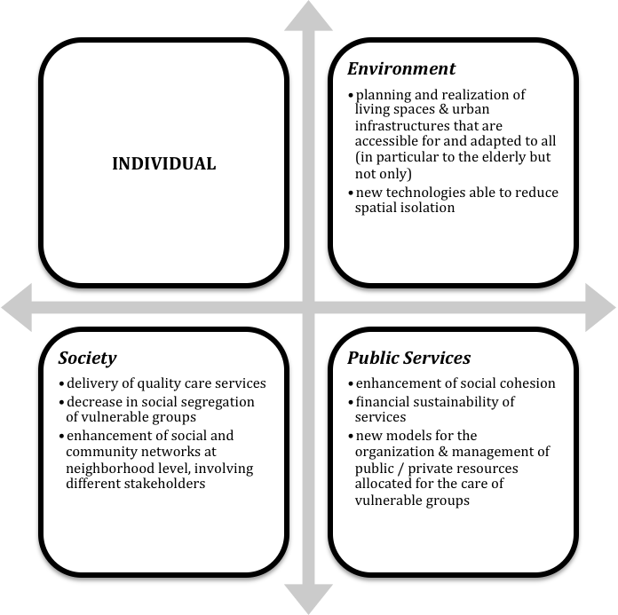

Slide 5
Communication Tasks PPs
A “map” with the communication tasks, their timelines, and who will be responsible for each.
The schedule is meant to be a toll for enabling the project to be implemented with maximum effectiveness and minimal risk of omission, confusion and disagreement.
Role of central coordination (in order to create a common identity of the project, with local adaptations= CM (Communication Manager)

Slide 7
SWOT - A short(ed) Context Analysis...
focus on Strengths & Weaknesses; Opportunities & Risks, namely on internal & external factors that depend either on features of the internal organization, either on the environment outside the project
If done regularly, it identifies (regularly) potential areas where the Operational Communication Plan should concentrate with more strength both at Project /local level
overview of the current situation in terms of general information (who is communicating and its mission), of the territory / population (whom are we communicating with) & of the project itself (what are we communicating)

Slide 8
Strenghts:
- Project Structure /Main Themes /Objectives : ambitious project with SMART project objectives (Specific, Measurable, Action-oriented, Realistic, Time-bound)
- PPs: good links with local authorities & at the regional level, good technical experts, good reputation for creating a favorable environment, dedicated project staff passionate about the project (PPs, LP – coordinators)
- Website: well structured info site on Helps that allows to improve contents easily
Weaknesses:
- Delays (implementation) - project implementation / outputs & internal /external communication gaps
- number of promotional articles & lack of a centralized media archive (in order to have a general overview on what all PPs have done so far) – e.g. 3/4 informative dissemination articles /year (1st, 2nd & 3rd year) should have been published at local level (in accordance with the Application File) by each partner to present the project objectives, activities and results; 3 scientific articles (published in accordance with the Application File -month 32- in specialized magazines addressed to specialized target groups, mainly socio-economic and urban planning sectors)
- newsletter has to get supervised by the communication manager & should be a result of joint work between the communication manager,LP staff, PPs, with the involvement of external bodies like publi/private institutions, NGOs or other social partners who can contribute with articles or. the newsletter should be printed out regularly (Helps Magazine) while it can also be published in electronic format with the support of PP4 (e-newsletter) and made available through the website or an e-mail version.

Slide 9
Opportunities:
- regular internal communication ; (better) match resources and capabilities to local environments on SPECIFIC communication objectives & prioritize and profile target audience to overcome budget constraints (act “glocal” - !!! target audience through site selection)
- e.g. Local Regional Media (local politicians, local authorities and communities, general public (Readers of local newspapers tend to be loyal, reading every day/week and each copy read by several people); National Media: politicians, policy makers and opinion shapers, other media, partners and employees, general public (readership targeted by lifestyle or socio-economic group ); International media: analysts, policy makers, regulators, international colleagues, EU and individual governments
- News agencies: all substantial media subscribe to newswires so a newswire story has very broad impact across media; Specialised Press: specialist analysts;; Magazines: internal magazines of institutions; - Radio, TV, Social media…etc etc
Threats:
- underestimate the importance of communication / communication needs as a whole may lead to improvisation. Sometimes the implementing activities take more time then expected but delays don’tjustify improvisation, as in a broader context, they would have “collateral effects” on the Helps brand as a whole and on reputation
- Other big organizations can overshadow the project messages as they might have similar messages when dealing with issues that are similar to the ones at the core of Helps
- Too technical jargon in HELPS communication outputs although communication among experts is different from that with the public. Communication among experts requires the readers’ complete attention, since they are already interested in the information because they need it. On the contrary, non expert-readers (or listeners, viewers, visitors, etc.) usually do not have any particular reason to pay attention to what is being said. They do not have to listen. Their attention must be won, otherwise any effort becomes useless.

Slide 10
What’s next?
Internal Communication:
Online platform to share info in
“real time”?!
GANTT for Tasks?
Communication Sessions?
External Communication:
Outputs (PPs & projects
attn. deadlines)

Slide 11
Don’t forget about our funders (attn. publicity obligations)

Slide 17
Last but not least…
Become our friends on Facebook
TeamHelps CentralEurope - http://www.facebook.com/helps.project
Like the HELPS Project Page on Facebook
www.facebook.com/HelpsProject.CentralEuropeProgramme?ref=hl
Follow us on Twitter
https://twitter.com/HELPSproject
Send your feedback /ideas
to the HELPS email account

